Slide 1
MY HOME
GARBIN SCARIA

Slide 2
CONTENTS
ABSTRACT
REQUREMENTS
​FEATURES
TECHNICAL ASPECTS
​CHALLENGES
FUTURE ENHANCEMENTS
CONCLUSION

Slide 3
ABSTRACT
This abstract outlines a household management system that aims to facilitate efficient communication and task allocation between users, administrators, and employees. The system allows users to select employees based on their postal codes and provides contact details, enabling users to easily reach out to employees via phone calls or WhatsApp. Once contacted, employees can offer tenders to users, who can then select the most suitable tender. Additionally, the system supports various roofing tasks to be carried out as part of its service offerings.
By implementing this household management system, users will be able to streamline their search for employees based on their geographic proximity, simplifying the process of finding suitable household help. The system enhances communication between users and employees by providing direct contact information, enabling seamless interaction and effective coordination. Furthermore, the ability to receive tenders from employees gives users the flexibility to select the best offer based on their requirements and budget.
With a specific focus on roofing tasks, the system ensures that users can easily access services related to roof repairs, installations, or maintenance. By integrating these functionalities into a single platform, the household management system enhances the overall user experience, providing convenience, choice, and efficiency in managing household tasks

Slide 4
REQUREMENTS
1.CRUD operations
2.create profile of users
3.register service providers
4.select employees for users
5.select users for employees
6.prepare tenders by employee
7.view tenders by the users
8.users can view the employees contacts info
9.admin dashboard to delete services
10.users can give feedback to the admin

Slide 5
features
User-Admin-Employee Roles: The system differentiates between users, administrators, and employees, each with their own set of functionalities and permissions.
Employee Selection by Postal Code: Users can search and select employees based on their proximity to their location, ensuring convenient access to household services.
Contact Information: Users can view the contact details of selected employees, such as phone numbers and WhatsApp IDs, making it easy to initiate communication and discuss requirements.
Communication Channels: Users can directly call or message employees through phone calls or WhatsApp, providing a convenient means of contacting and discussing tasks.
Contact Information: Users can view the contact details of selected employees, such as phone numbers and WhatsApp IDs, making it easy to initiate communication and discuss requirements.
Communication Channels: Users can directly call or message employees through phone calls or WhatsApp, providing a convenient means of contacting and discussing tasks.
Tendering System: Employees can submit tenders, which are proposals outlining the scope of work and associated costs. Users can review and compare tenders to select the most suitable option.
Tender Selection: Users have the ability to evaluate and choose the tender that best fits their needs, considering factors such as pricing, expertise, and reputation.

Slide 6
Technical aspects
Django Framework: Django is a core component of the project, providing the web application framework and handling various aspects such as routing, request handling, and template rendering.
Third-Party Libraries: The project may incorporate various third-party libraries and packages to enhance functionality.
Jazzmin is a Python package that provides a customizable and modern interface for the Django administration site. It is a third-party library that enhances the default Django admininterface, offering a more visually appealing and user-friendly experience for administrators.

Slide 7
architecture
The architecture of the project will depend on its specific requirements and complexity. However, a common approach for a Django project is to follow a layered architecture, separating concerns into different components:
Presentation Layer: This layer includes the user interface components, such as templates and views, responsible for rendering and displaying the application's data and functionalities to users.
Application Layer: The application layer contains the business logic and processes user input received from the presentation layer. It consists of Django views, forms, and other application-specific logic.
Domain Layer: The domain layer represents the core business entities and rules. It includes Django models, which define the data structure and business logic related to the application's domain.
Data Access Layer: This layer is responsible for interacting with the database and managing data persistence. It involves Django's ORM and related database operations.
External Services and Integrations: Depending on the project's requirements, there may be additional layers or components for integrating external services, APIs, or other systems.

Slide 8
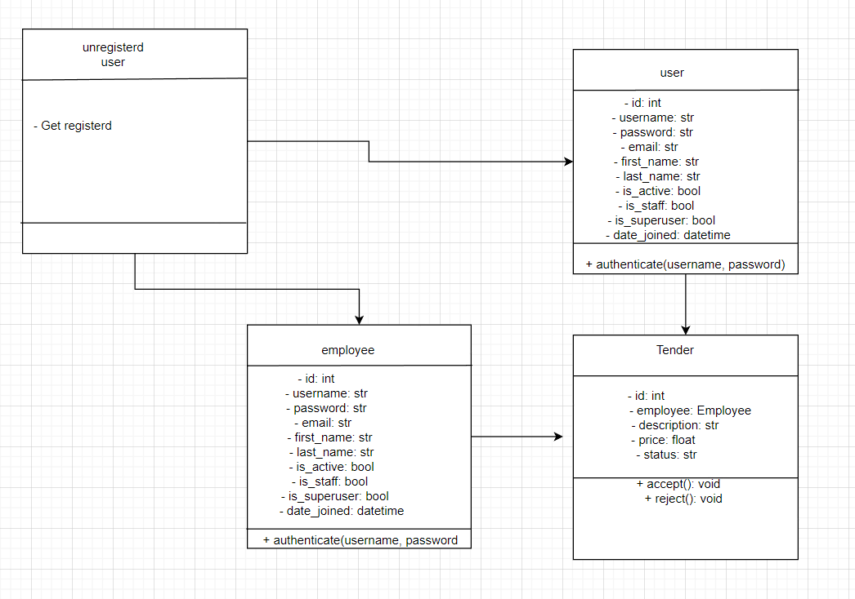
Class diagram

Slide 9
challenges
Not familiar with Django
Crash database during work
Create 2 types of users
Dynamic home page

Slide 10
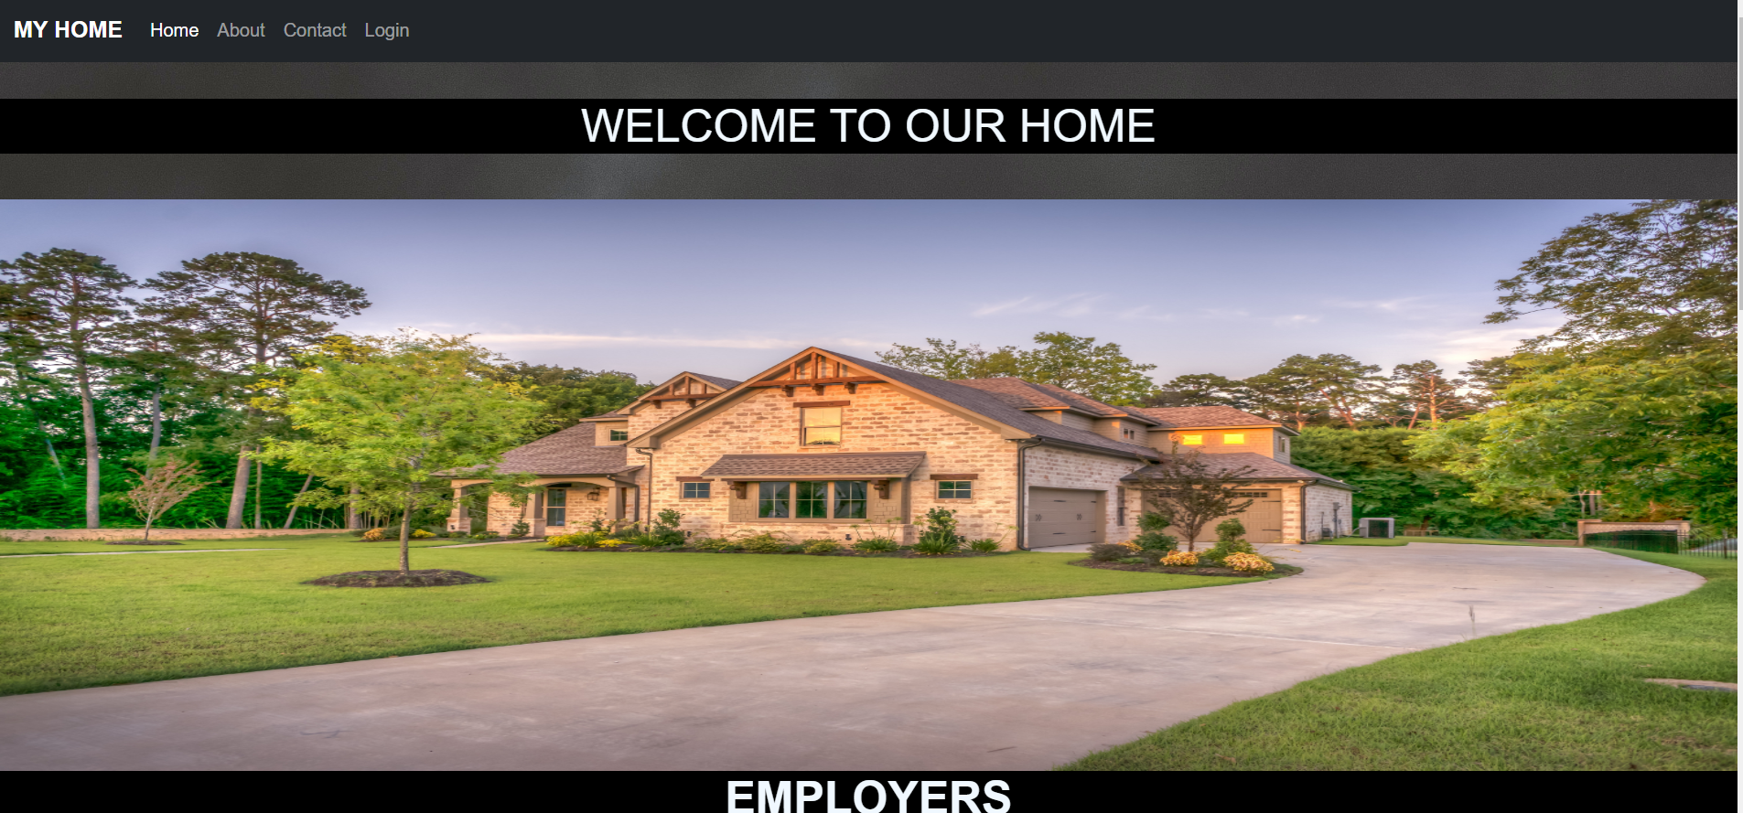
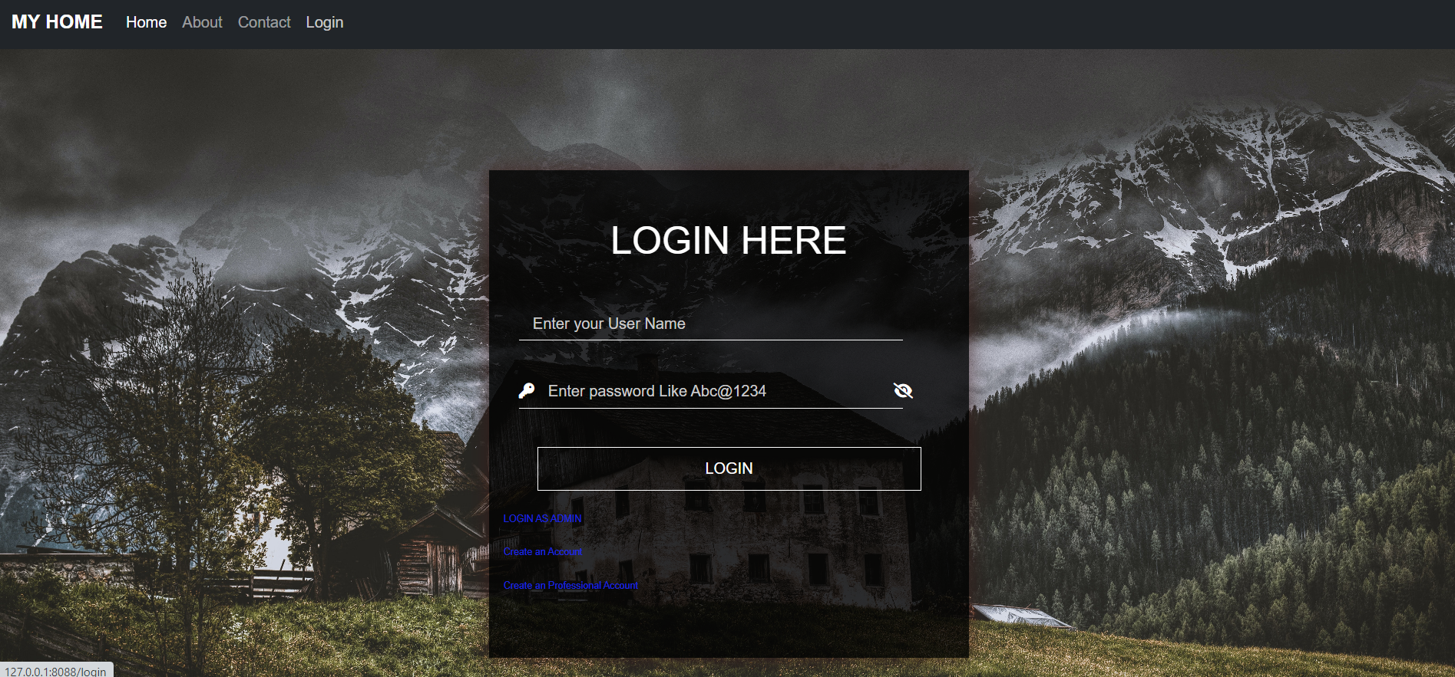
screenshots
Home page Login page

Slide 11
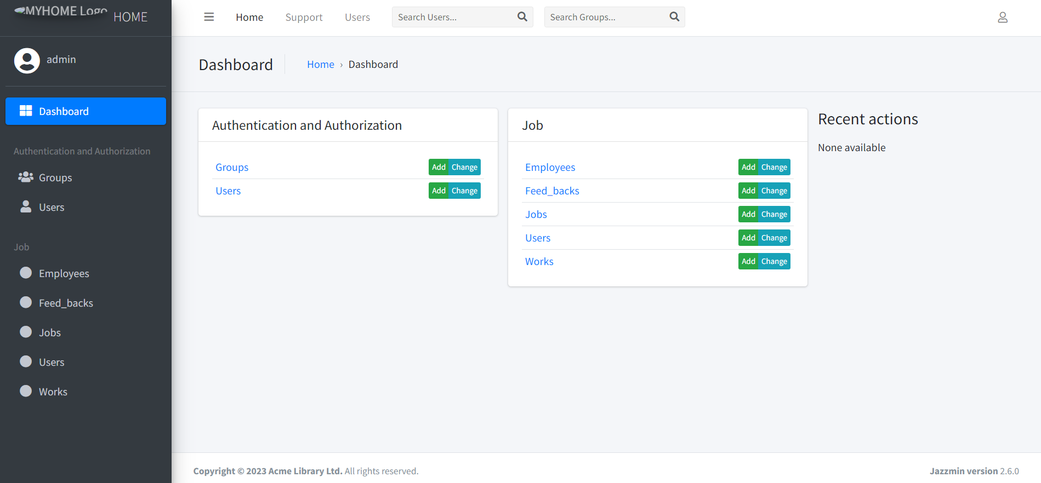
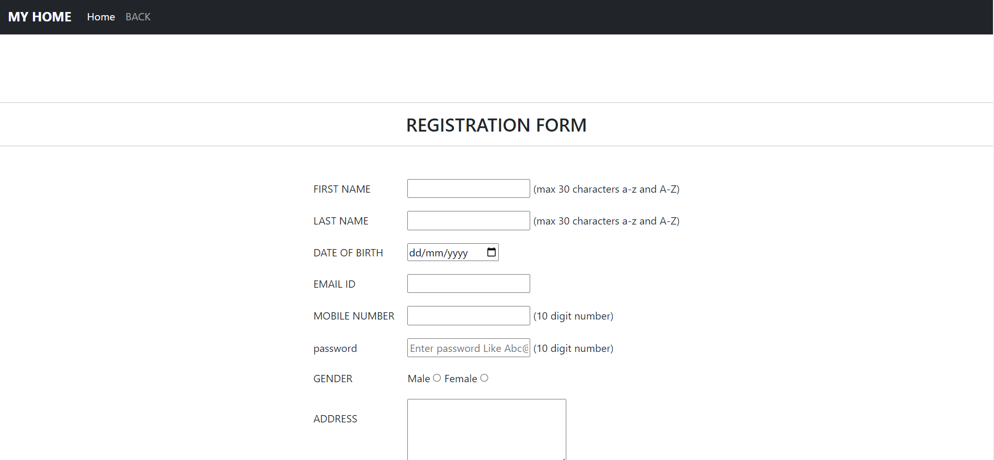
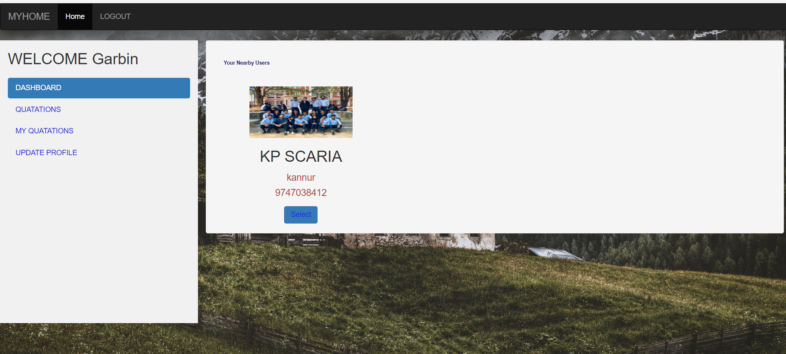
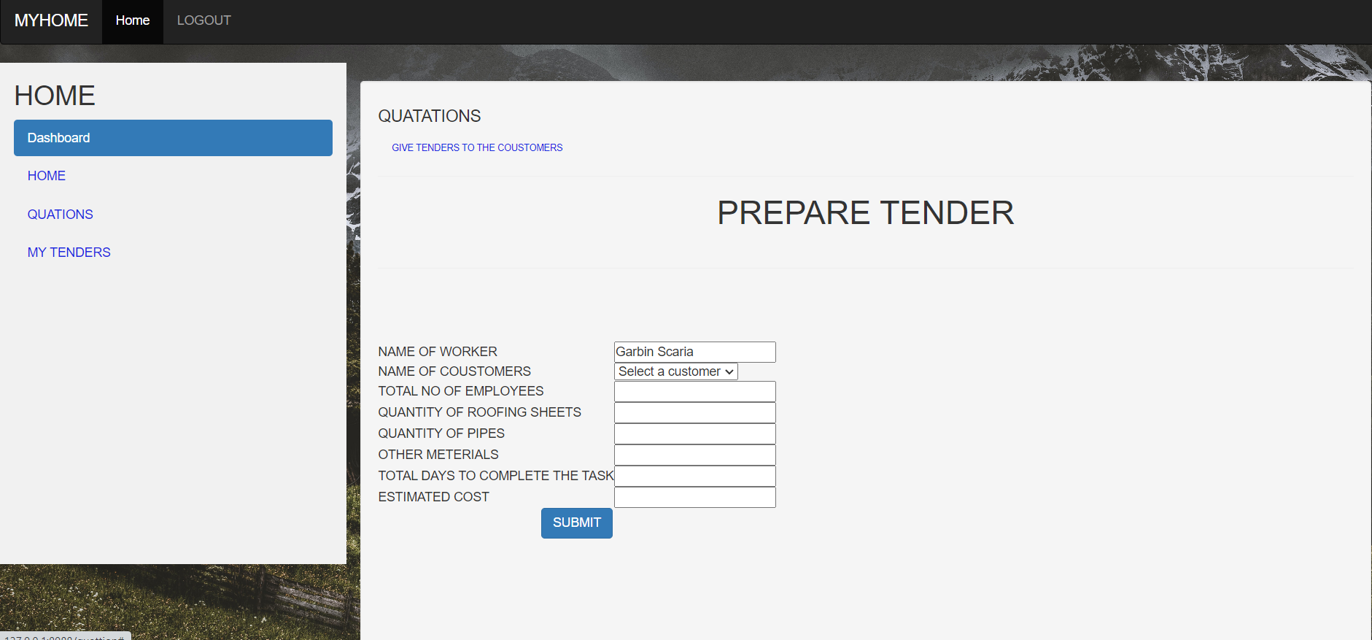
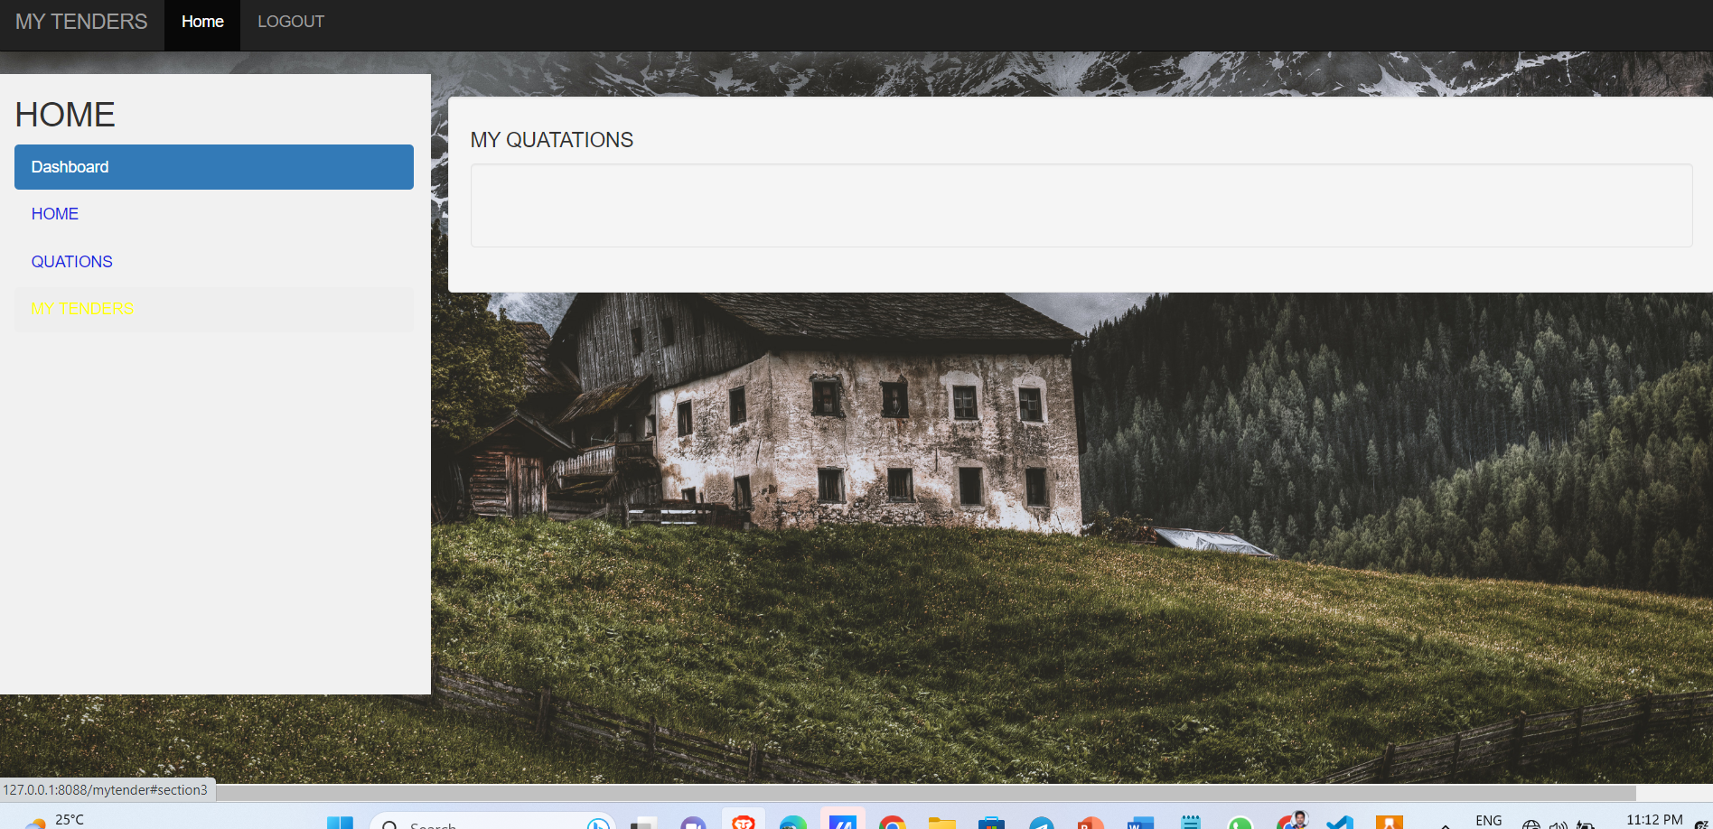
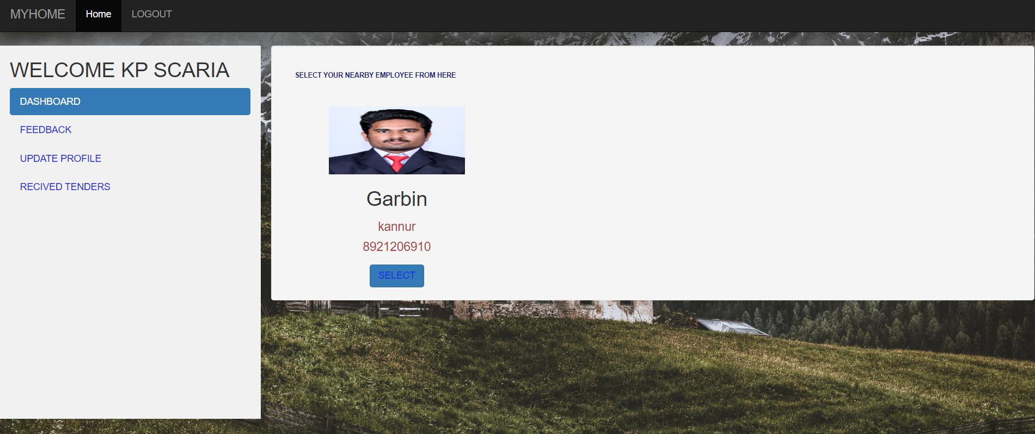
ADMIN PAGE REGISTRATION EMPLOYEE HOME
PAGE
GIVE TENDER MY TENDERS USER HOME

Slide 12
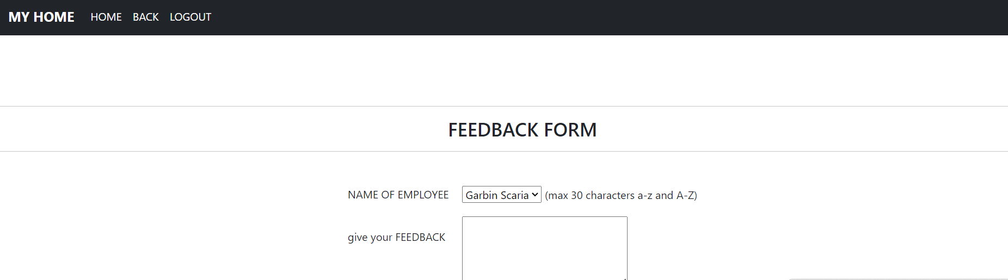
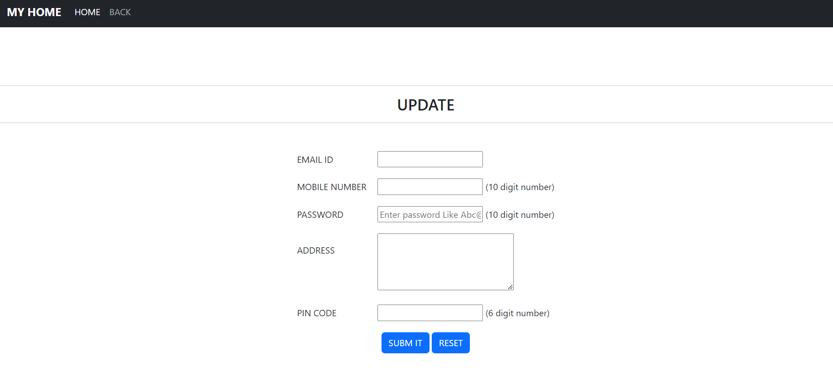
FEEDBACK FORM UPDATE

Slide 13
FUTURE ENHANCEMENT
Advanced Search and Filtering: Implementing an advanced search functionality that allows users to filter employees based on various criteria such as skills, availability, ratings, and reviews. This would help users find the most suitable employees more efficiently.
Online Payment Integration: Integrating a secure online payment system to allow users to make payments directly through the platform for services rendered. This would enhance convenience and streamline the payment process for both users and employees.
Employee Scheduling and Availability Management: Adding features for employees to manage their schedules and availability, enabling them to update their working hours and communicate their availability to users. This would help in better task planning and coordination.

Slide 14
conclusion
the household management system project aims to simplify and streamline household management tasks, empowering users, administrators, and employees to efficiently collaborate and accomplish their objectives. By leveraging technology and implementing a user-friendly interface, the project enhances convenience, choice, and effectiveness in managing household responsibilities.

Slide 15
references
1.Django Official Documentation
2. Jazzmin Documentation
3. Python Package Index (PyPI)

